Slide 1
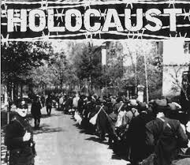
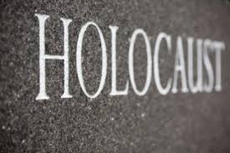
THE HOLOCAUST

Slide 2
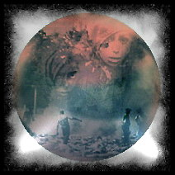
THE HOLOCAUST
In 1933, Adolf Hitler seized power in Germany.
In 1935, the infamous Nuremberg Laws were passed. In another attempt to purge Germany of her Jews, a roundup of Jews with Polish citizenship was enacted in October 1938.

Slide 3
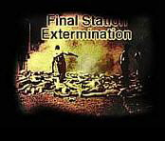
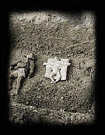
THE HOLOCAUST CHILDREN
During 1941 Hitler began preparing for the Final Solution.
It can be ruled out that the massive preparations for the systematic murder of European Jews in extermination camps in Poland, undertaken in spring and summer of 1942, were taken without his consent or his knowing.

Slide 4
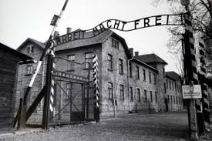
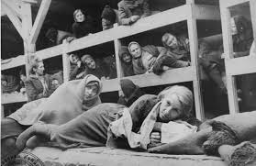
CONCENTRATION CAMPS
The first concentration camps in Germany were established soon after Hitler's appointment as chancellor in January 1933.
Concentration camps (Konzentrationslager; abbreviated as KL or KZ) were an integral feature of the regime in Nazi Germany between 1933 and 1945.

Slide 5
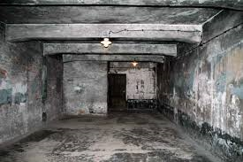
GAS CHAMBERS
A gas chamber is an apparatus for killing humans or animals with gas, involving a sealed chamber into which a poisonous or asphyxiant gas is introduced.
Gas chambers were used as a method of killing for condemned prisoners in the United States beginning in the 1920s and continues to be a legal extermination method in 3 states.

